Slide 1
Future State Reports Mock up Draft v 1
SAMPLE

Slide 2
Field Dashboard
Following are the key dashboards elements:
Home
Summary of Field Metrics designed for Sales Leadership
Calls & Targets
Overview of Planning and Targets for HCAS and Sales Leadership
Account Profile
Detailed information of an HCP for HCAS and Sales Leadership
Performance
Sales Performance, Goals and Attainment for Sales Leadership
Reports
List of Standard Reports for HCAS (field users)

Slide 3
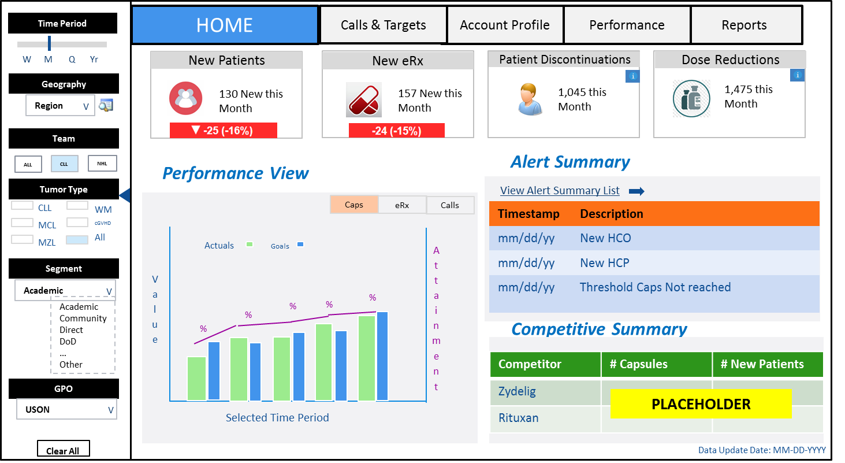

Slide 4
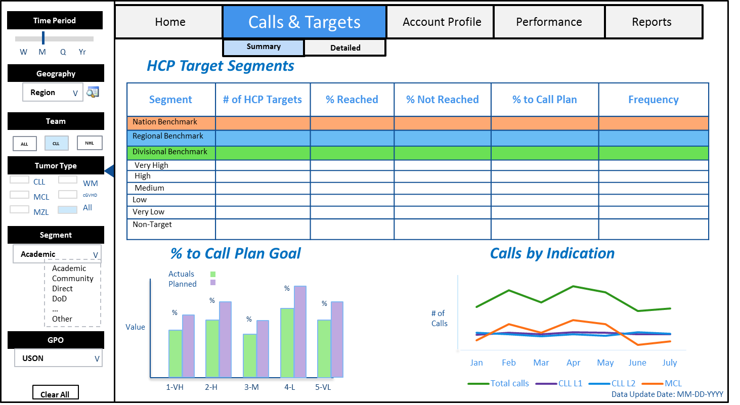

Slide 5
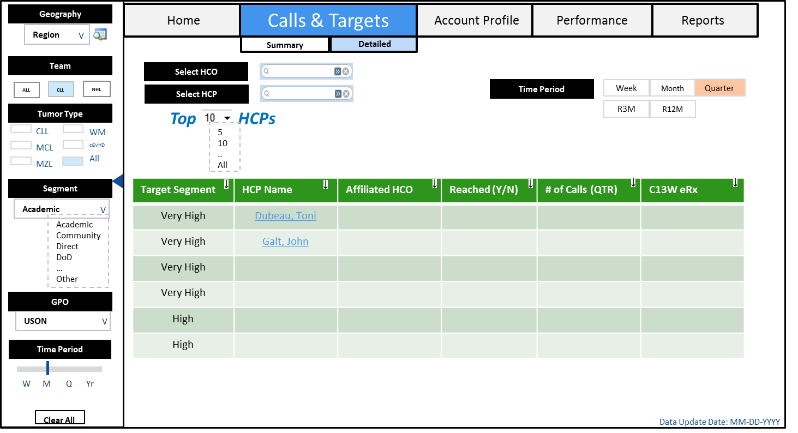

Slide 6
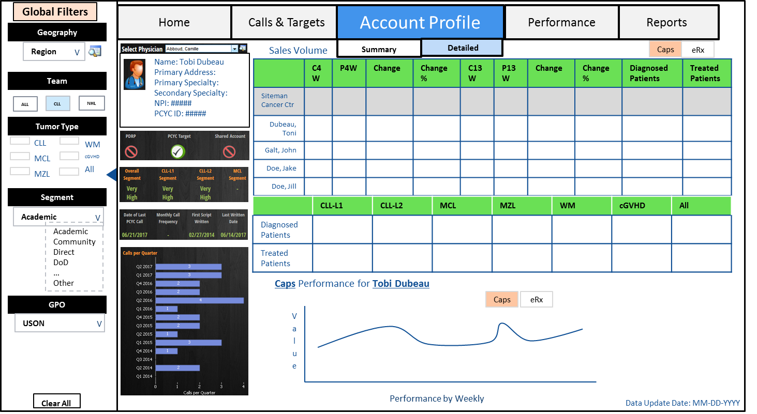

Slide 7
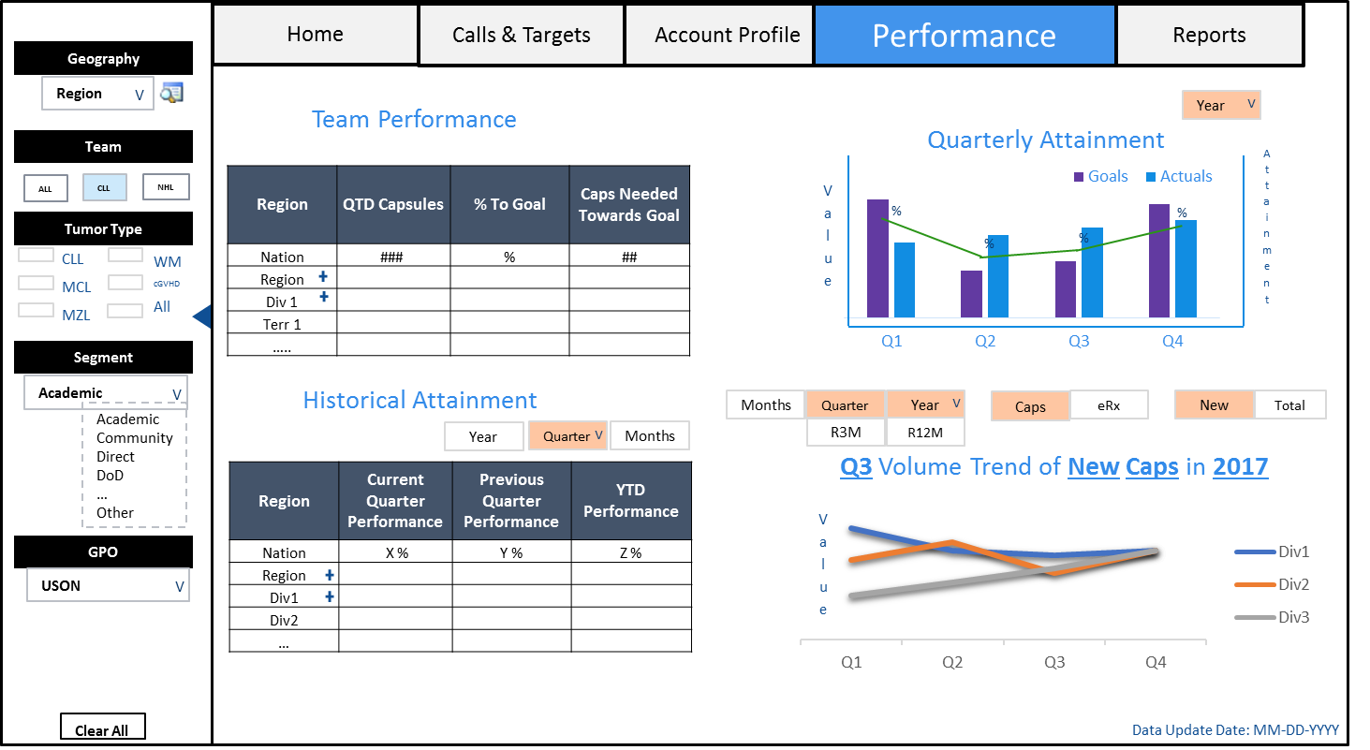

Slide 8
